Slide 1



UCT Quantum Computing Society 2026
Societies Recognition Meeting
13 October 2025

Slide 2


Agenda
Introduction
Plan of action
Proforma constitution
Collaboration in the South African quantum ecosystem
Administration and communication
Closing

Slide 3
Agenda
Introduction
Plan of action
Proforma constitution
Collaboration in the South African quantum ecosystem
Administration and communication
Open Floor Discussion
Closing

Slide 4


Introduction
Welcome to the UCT Quantum Computing Society (UCT-QCS)! We exists to advocate for Quantum Computing in Africa by building an active ecosystem at University of Cape Town. Our mission is to empower students to become future leaders in the field through education, collaboration, and hands-on exposure to real-world quantum technologies.

Slide 5


Plan of Action
Our key objectives include:
Building a strong community of students passionate about quantum and quantum computing.
Fostering learning opportunities through meetups, seminars, and hands-on projects.
Facilitating meaningful engagement on discussions related to Quantum and Quantum Computing.
End Year
Celebration
Qiskit Fall
Fest
Annual General Meeting
Quantum
Talk/Outing
November
October
September
August
Qiskit
Hands-on
Games
Night
Exams
April
May
June
July
Basics of Quantum
Opening Event
Plaza Day
Meet and Greet
Computing
March
February
January
start

Slide 6

Proforma Constitution
On memberships
On rules and discipline
Members of the Society can be either ordinary members or honorary members, with ordinary members including any University student, any staff member with committee approval, and staff members who are not also students who can participate in Intervarsity competitions.
"All persons by becoming members of the Society submit themselves to the rules and discipline of the Society and the University."
On meetings
On diplomacy
"A meeting of the Society may be either the Annual General meeting, a general meeting or a special meeting;"
"All meetings shall be well advertised."
"Except where otherwise provided in this Constitution all matters determined by a vote shall be decided by a majority of those present and voting"
"The Committee shall serve for one year, or until the election of a new committee, whichever period is the shorter"

Slide 7

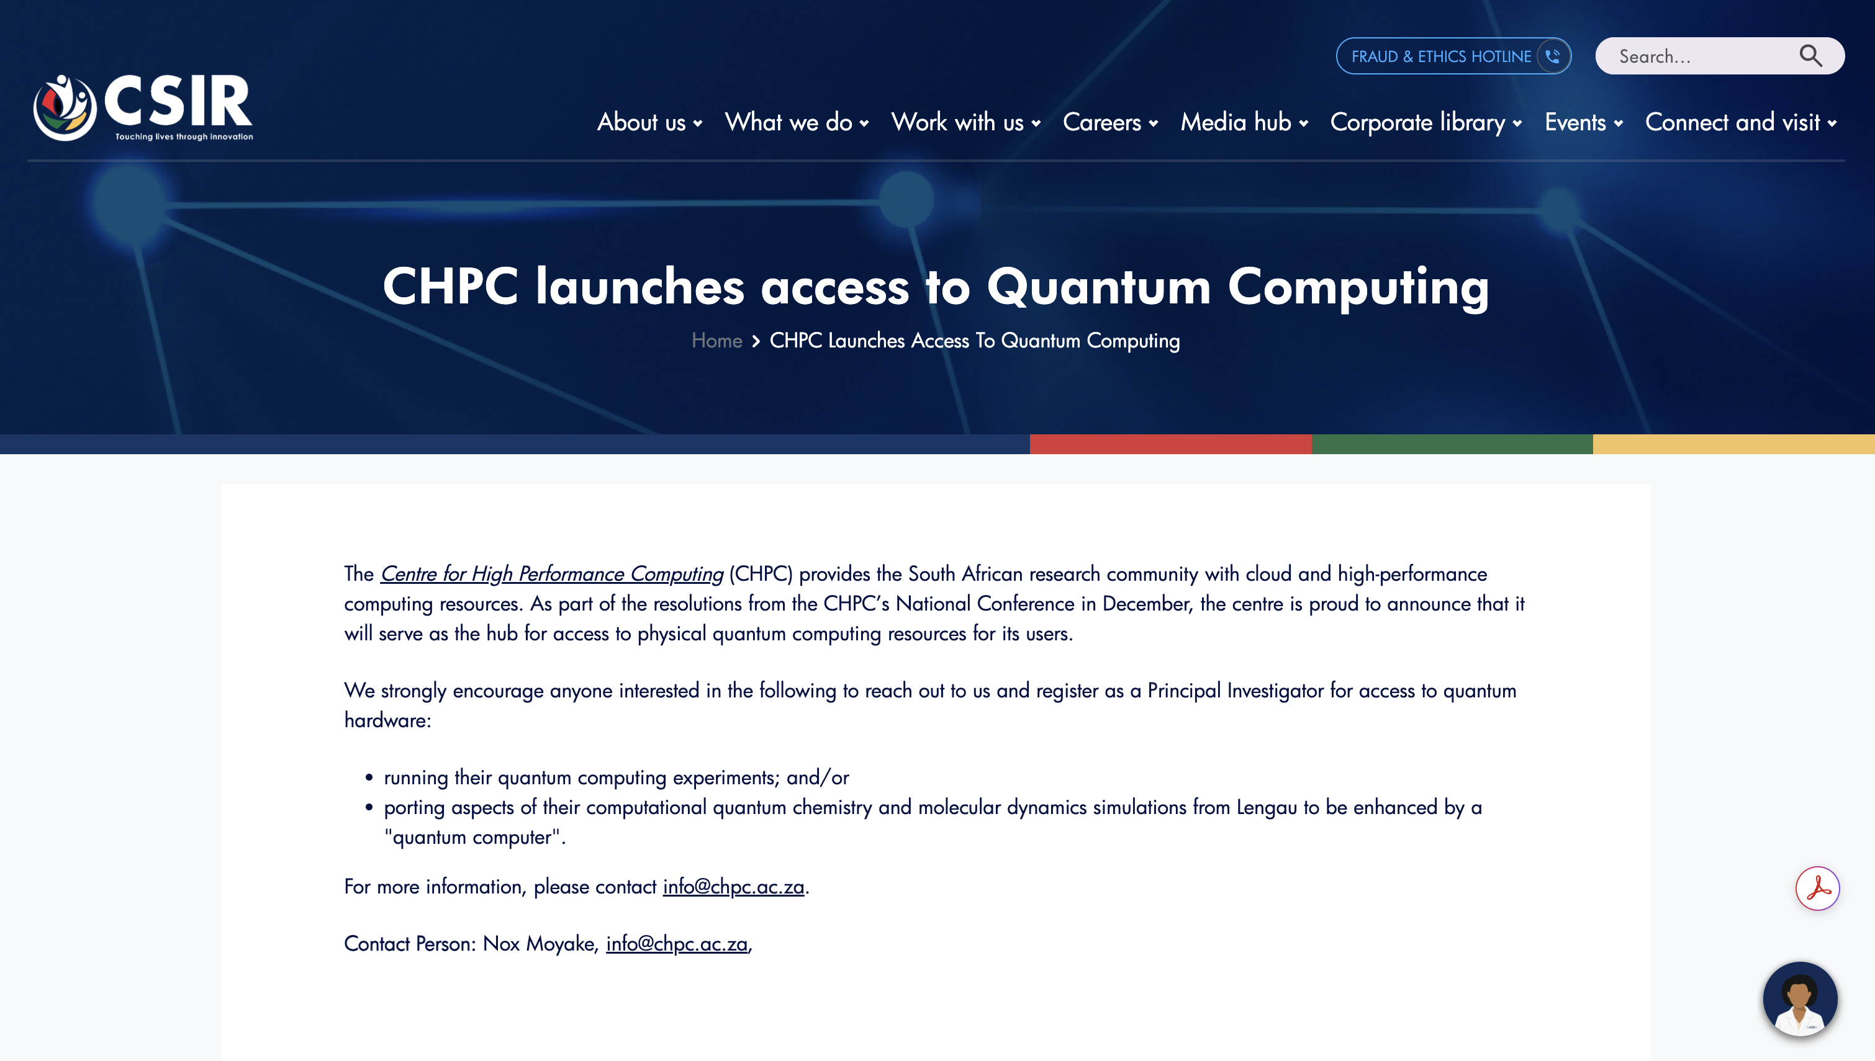
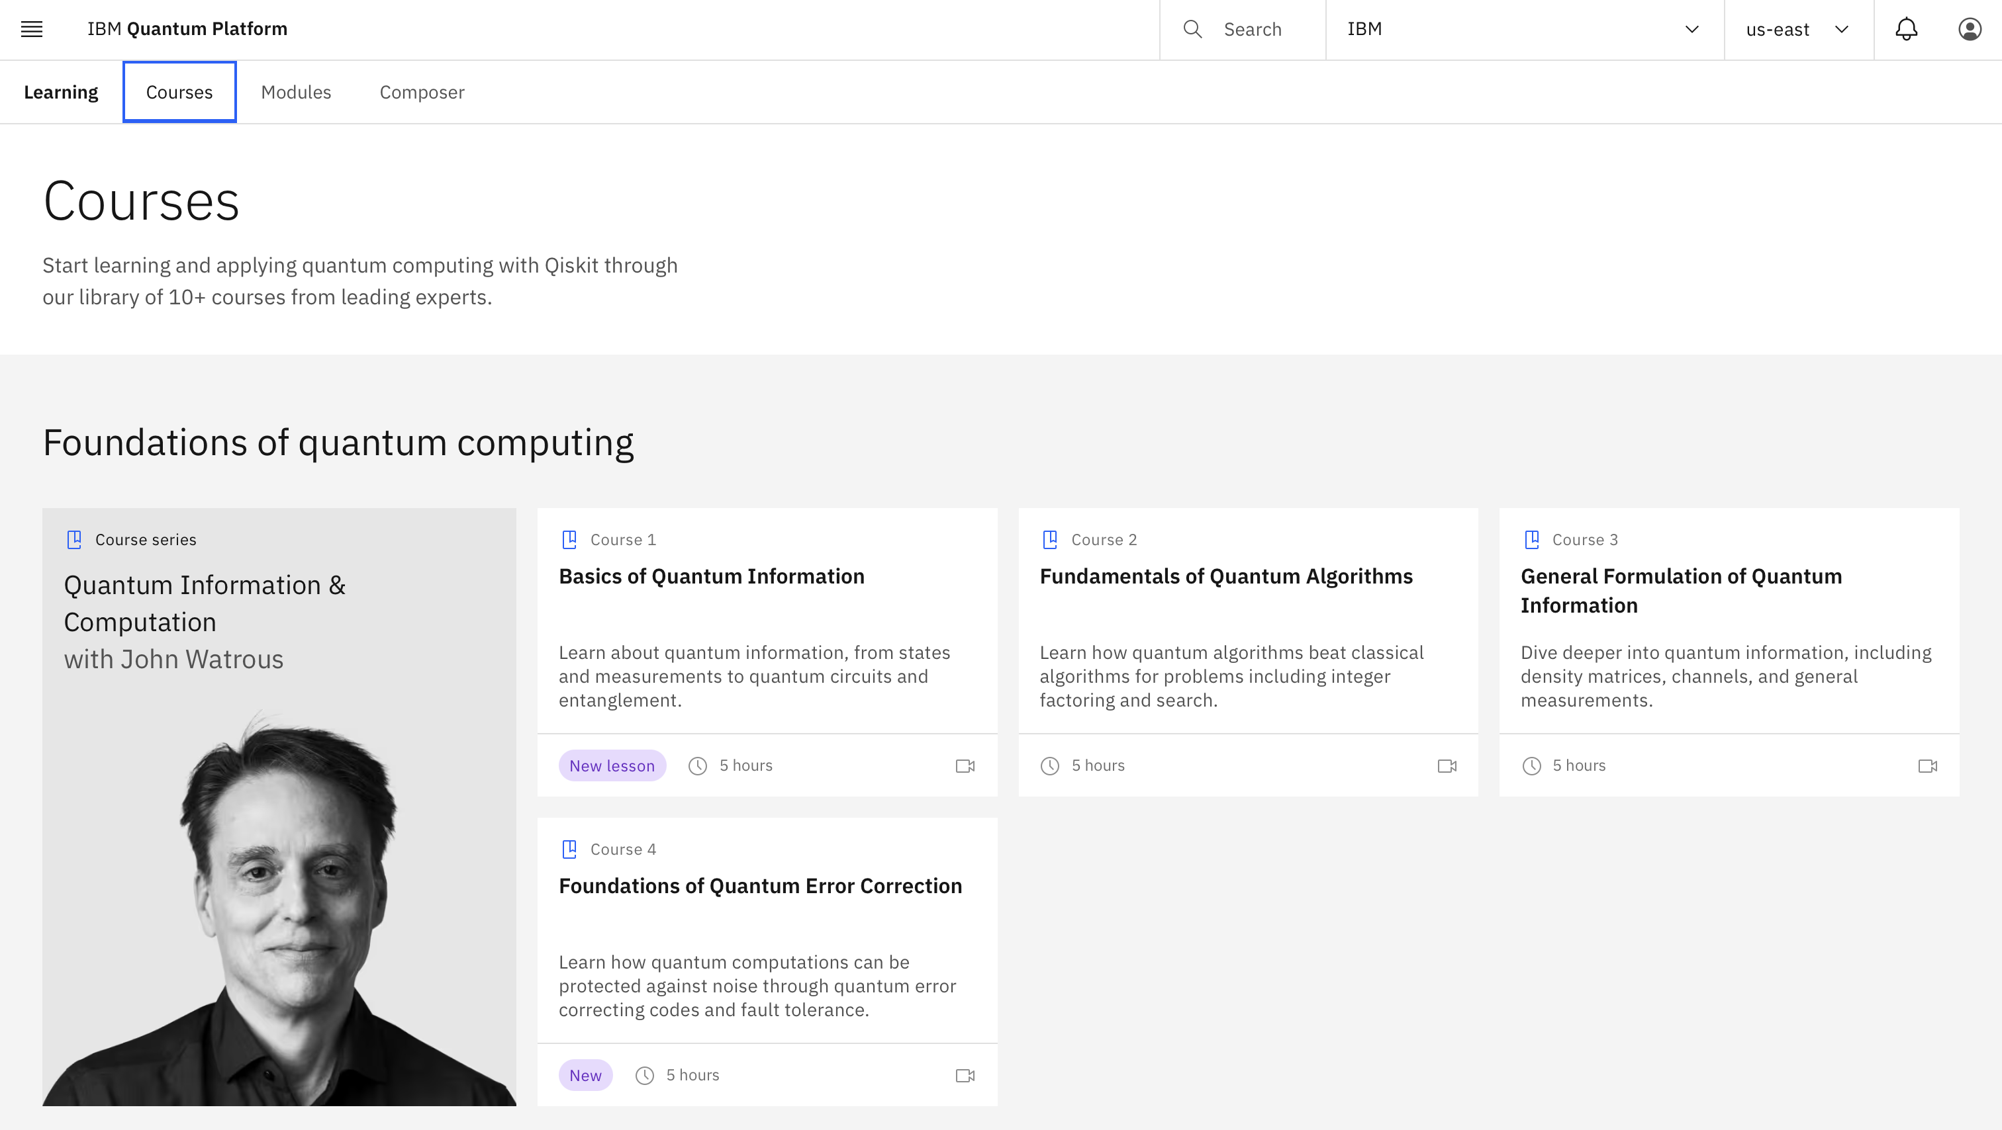
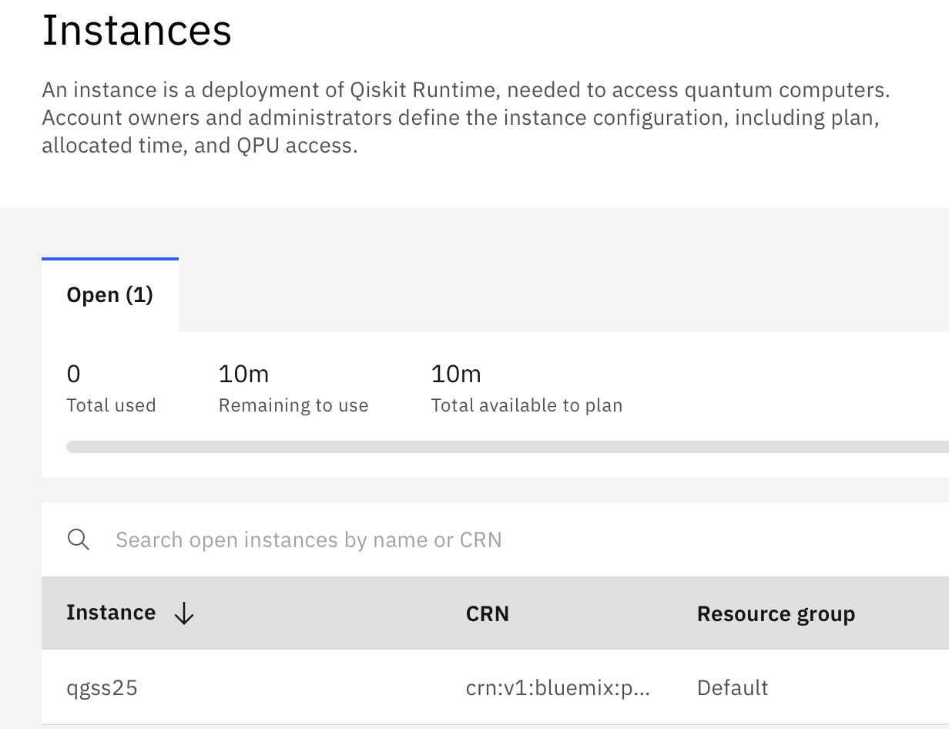

Slide 8
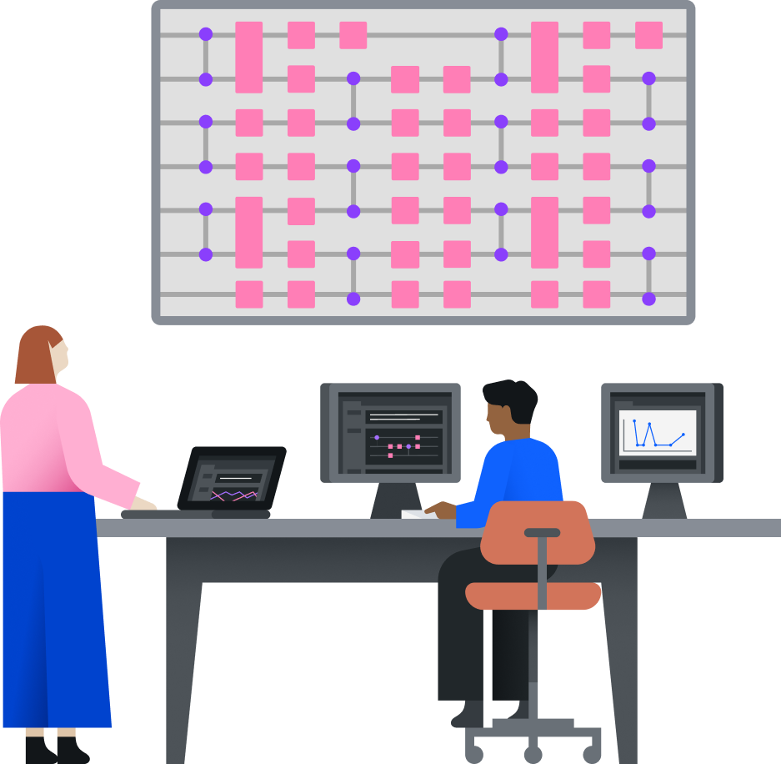

Qiskit Global Summer School
Slide ID: 360
Our largest educational event every year. Two weeks of lectures, labs, Q&As, and community engagement.
Rooted in the IBM Quantum Learning courses, with new content each year.
6,000+ seats sold out in 2024.
Live event featuring badges for completion, extra assignments for partners, and more.
After the event is over, the lecture material becomes available on YouTube.
Notes:
The Qiskit Global Summer School is a two-week intensive summer program designed to empower the quantum researchers and developers of tomorrow with the know-how to explore the world of quantum computing, as well as refresh and sharpen the industry professional’s skills. Using hands on examples, the syllabi will guide students through areas of near-term practical importance.

Slide 9

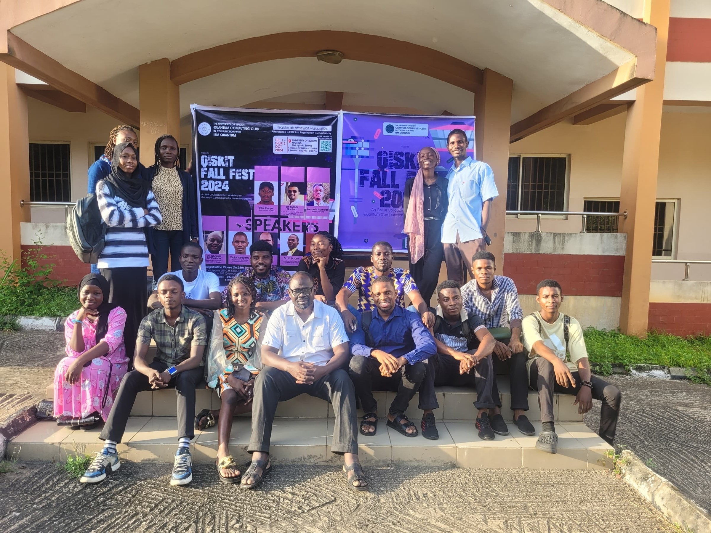
Qiskit Fall Fest
Slide ID: 361
Student-led quantum computing events on campus ↳ Crafted by student leaders, supported by IBM
Working with the student leaders of today to shape the industry leaders of tomorrow
Organic growth of local communities
Since 2021:
195 Events
28k+ Attendees
(Pictured: 2024 Qiskit Fall Fest event at The University of Ibadan in Nigeria)
Notes:
Qiskit Fall Fest is a collection of quantum computing events that invites students, researchers and industry professionals around the world to participate in a wide array of quantum-themed activities, ranging from quantum challenges, to hackathons, and more. For each Qiskit Fall Fest, we partner with a select group of university students and other volunteer hosts to help them plan and run the global roster of Fall Fest events.
Image usage rights: This is from 2023 Fall Fest and users signed waiver. https://ibm.box.com/s/vuec0dtq0td4k5vzb4litk6zr1m0q9we

Slide 10
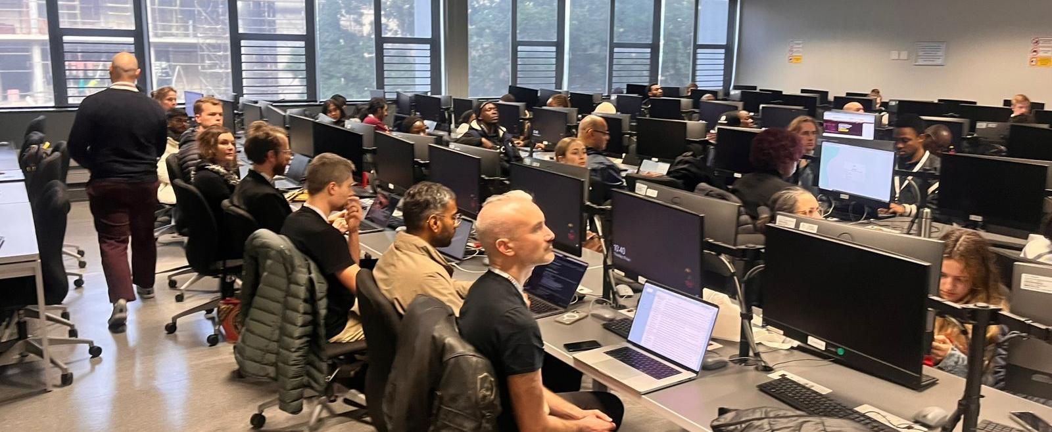
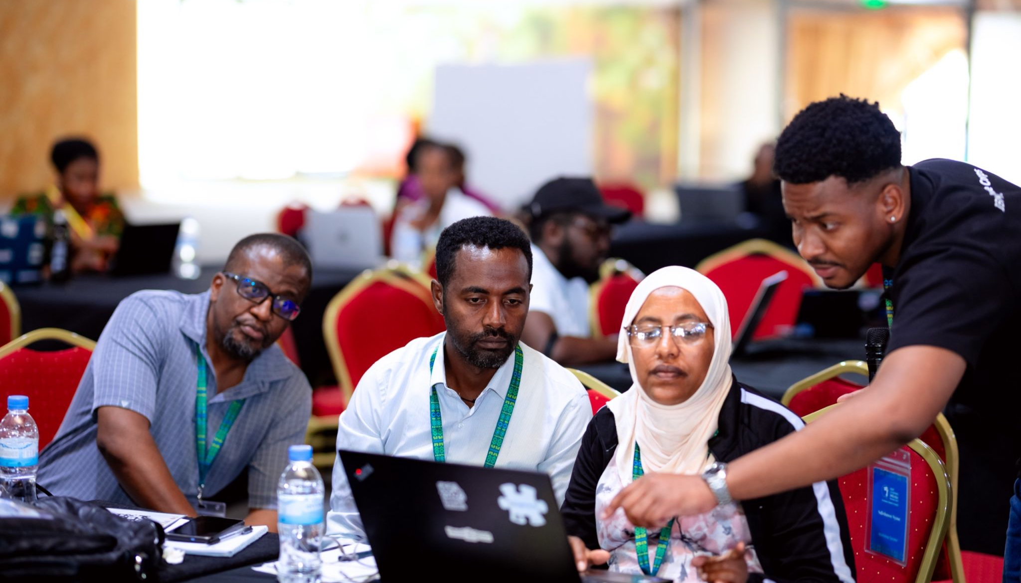
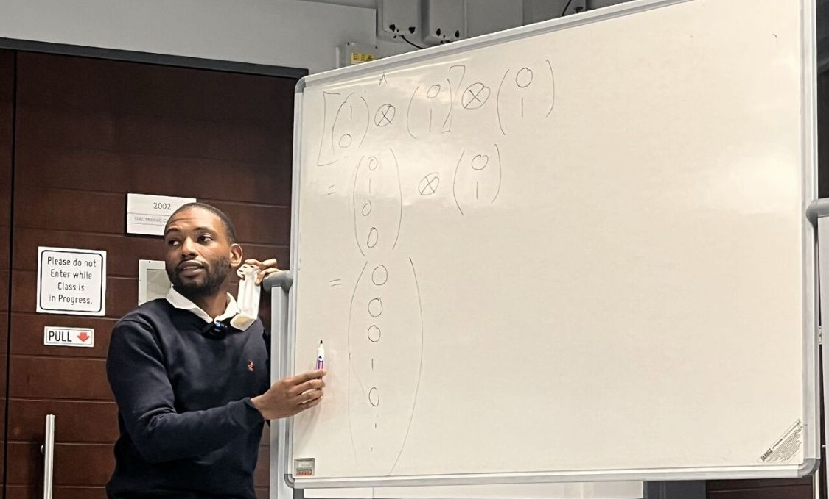
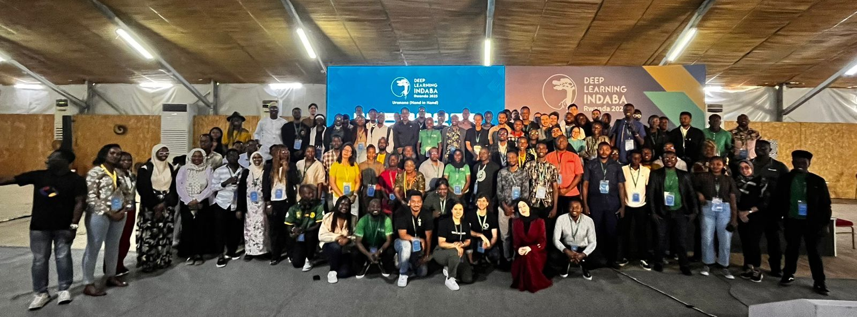

Slide 11



Administration and Communication
Candidate Chair
Bonga Njamela*
Sonwabile Baartman
Kenneth Freeman
Kellem Lengwati
Shiraaz Abrahams
Candidate Vice Chair
Siphesihle Gema*
Malefetsane Lenka
Kgotsofatso Mello
Andiswa Linda
Lunga Buthelezi
Shiraaz Abraham
Candidate Secretary
Kellem Lengwati*
Lunga Buthelezi
Kgotsofatso Mello
Yivani Mabono
Candidate Treasurer
Kgotsofatso Mello*
Yivani Mabono
Keith Matsiko
Ditiro Nkuna
Candidate Socials Manager
Celestin Nahimana*
Sphiwe Makenete
Tinashe Masvore
Sibusiso Khumalo
Nkcubeko Mjikeliso
Siphesihle Moloi
Kellem Lengwati
Wade Schroeder
Siyabonga Yende
Manganyi Yeuko
Communication and Collaboration
Industry Advisory Board
Ndivhuwo Nyase (IBM Research Africa)

Slide 12
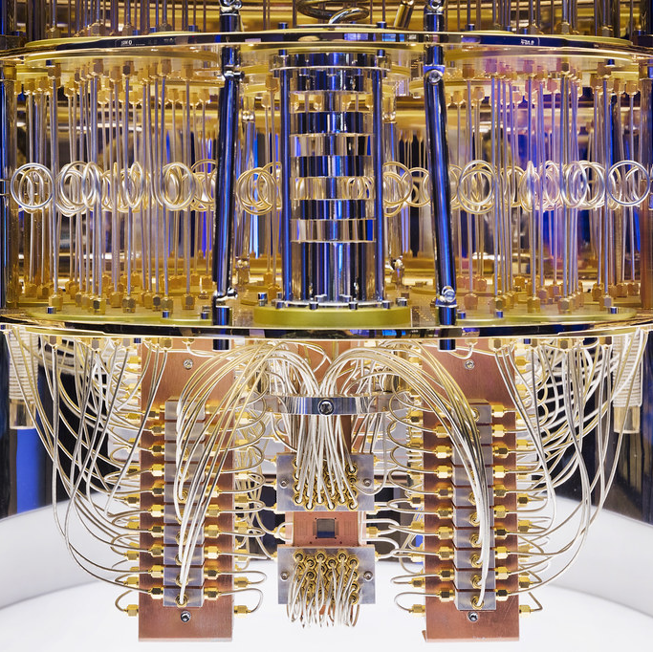
Thank you
Bonga Njamela +27 (0) 83 397 63 13 njmlun002@myuct.ac.za
ThePhoto by PhotoAuthor is licensed under CCYYSA.
ThePhoto by PhotoAuthor is licensed under CCYYSA.

